Slide 1

CSE200: Computer Aided Engineering Drawing
Department of Computer Science and Engineering
Md. Mafiul Hasan Matin
Lecturer
Dept. of CSE, East West University

Slide 2
What is drawing?
Drawing is a graphic language used to express ideas. In other words it is one means of communication.
It is used for:
– Research and Development,
– Design,
– Production,
– Construction,
– Operation,
– Maintenance,
– Installation, etc

Slide 3
Drawing as a Means of Communications
The v-block is to be made of cast iron and machined on all surfaces. The overall sizes are two and one-half inches high, three inches wide, and six inches long. A v-shaped cut having an included angle of 90° is to be made through the entire length of the block. The cut is to be made with the block resting on the three inch by six inch surface. The v-cut is to begin one quarter inch from the outside edges. At the bottom of the v-cut there is to be a relief slot one eighth inch wide and one eighth inch deep.

Slide 4
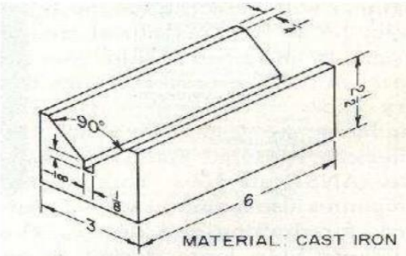
Drawing as a Means of Communications
The above explanation will be easily understood if the following graphical representation is used:

Slide 5
Graphic Language or Drafting
It is a form of communication that is technical and very exact
It is visual language
Utilize line, curves and symbols agreed all over the world.
Drafting: represent all graphic languages
Technical Drawing: Any drawing which expresses technical ideas including sketches, instrument drawings, charts, and illustrations

Slide 6
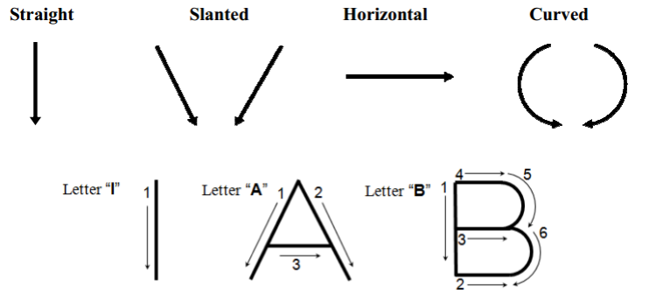
Lettering
Lettering plays a major role in overall appearance of a drawing and increases the readability of the drawing.
Lettering should be executed in one stroke as much as possible
Basic strokes:

Slide 7
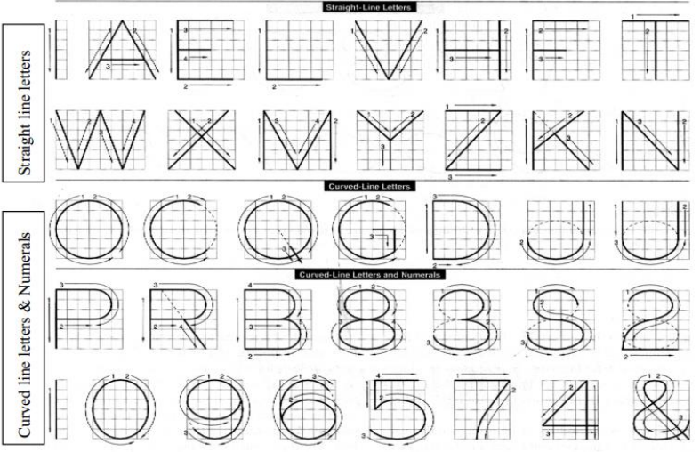
Uppercase letters and Numerals:

Slide 8
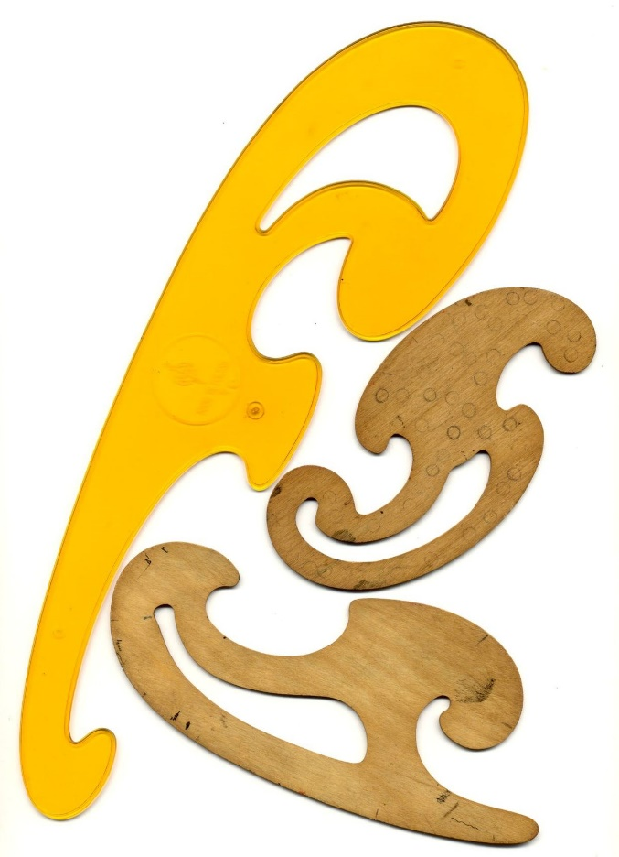
Drawing Instruments
List of drawing instruments:
Eraser
Erasing shield
Triangle (Set-square)
Architect’s or engineer’s scale
Irregular curves (French curve)
Drawing instrument set (Compass, Divider, extensions)
Protractor
Drawing board
T-square
Drawing sheets
Drafting tape
Drafting pencils
Pencil sharpener

Slide 9
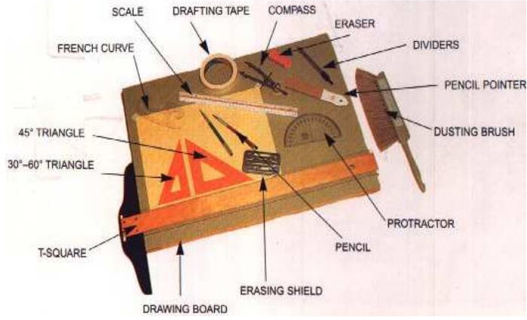
Drawing Instruments

Slide 10
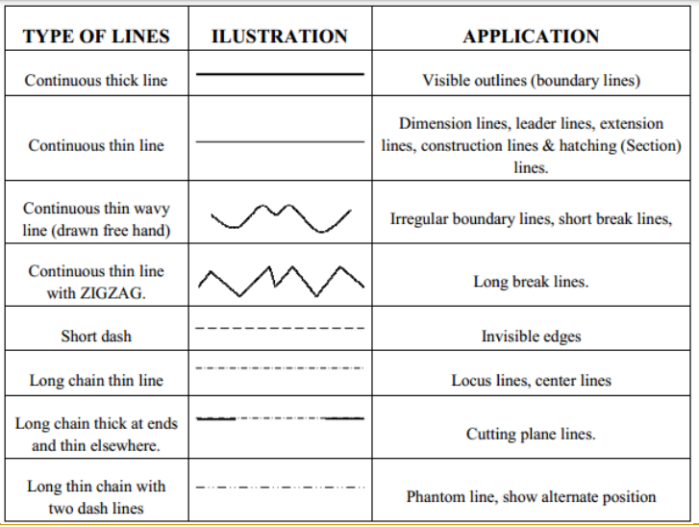
Types of lines

Slide 11
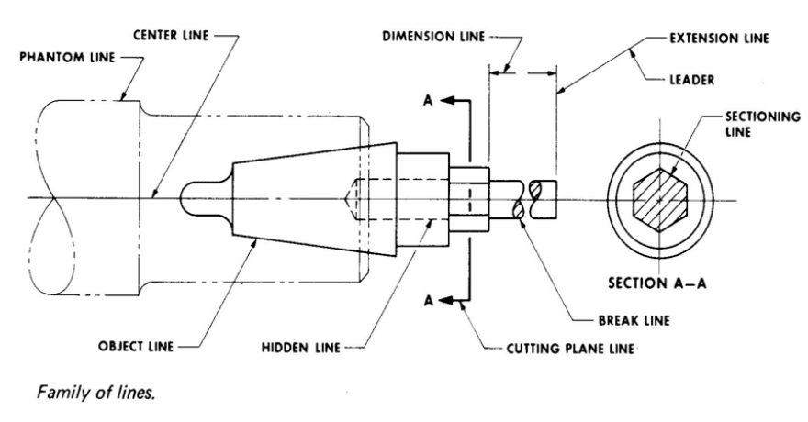
Types of lines

Slide 12
Dimensioning
The purpose of dimensioning is to provide a clear and complete description of an object. A complete set of dimensions will permit only one interpretation needed to construct the part
Dimension line is a thin line, broken in the middle to allow the placement of the dimension value, with arrowheads at each end.
A leader is a thin line used to connect a dimension with a particular area

Slide 13
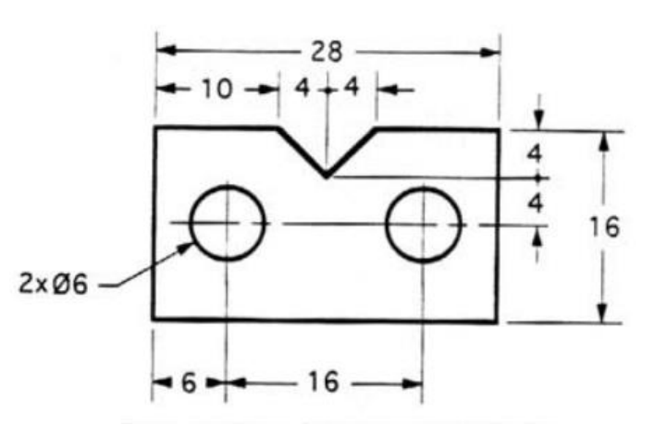
Dimensioning

